Slide 1
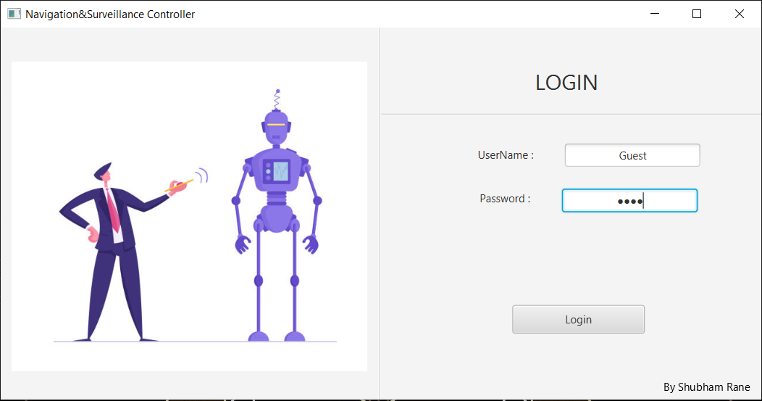
Login Page
First screen that will open is Login Screen that will allow operators to log in to the system and gain control of Unmanned Vehicle.
Login window interacts with database to fetch and validate username and passwords.

Slide 2
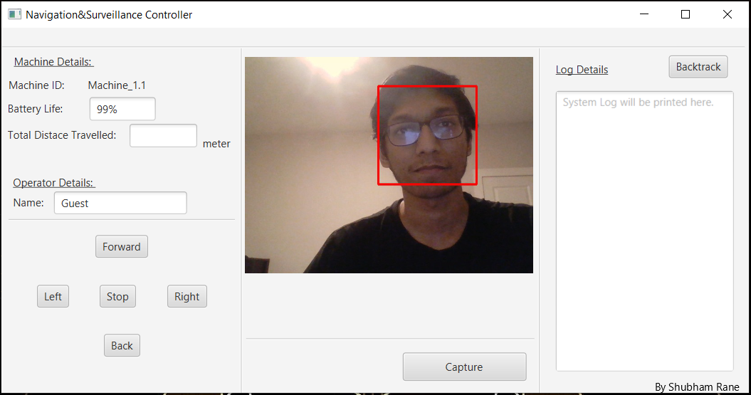
Empty Controller
Controller contains various panel with their respective jobs.
On top left corner there is Machine & Operator Details Panel that allows to see details of machine and operator logged in to the system like Machine_ID, its’s battery Life, amount of distance machine travelled in current session, Operator name or an ID that operator used to log in.

Slide 3
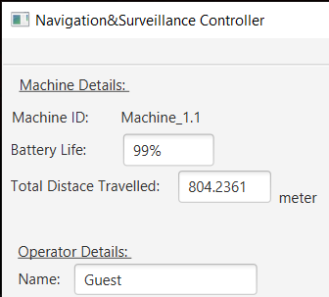
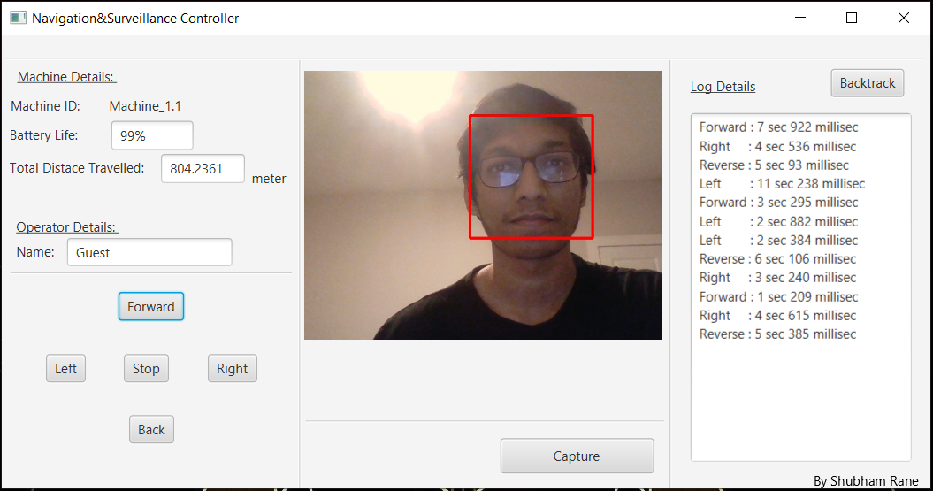
After machine moved
Bottom left corner is consist of Control buttons mapped with W, A, S, D and Spacebar for ergonomic control of vehicle.
As vehicle will move, on extreme right corner we can see Log details getting generated with the precision of milliseconds for movement is every direction.
Also, in machine details panel we can see change in total distance travelled by machine after every key release.
This distance is calculated with simple speed x time = distance formula with speed = 50mile/hr
( https://en.wikipedia.org/wiki/Radio-controlled_car )

Slide 4
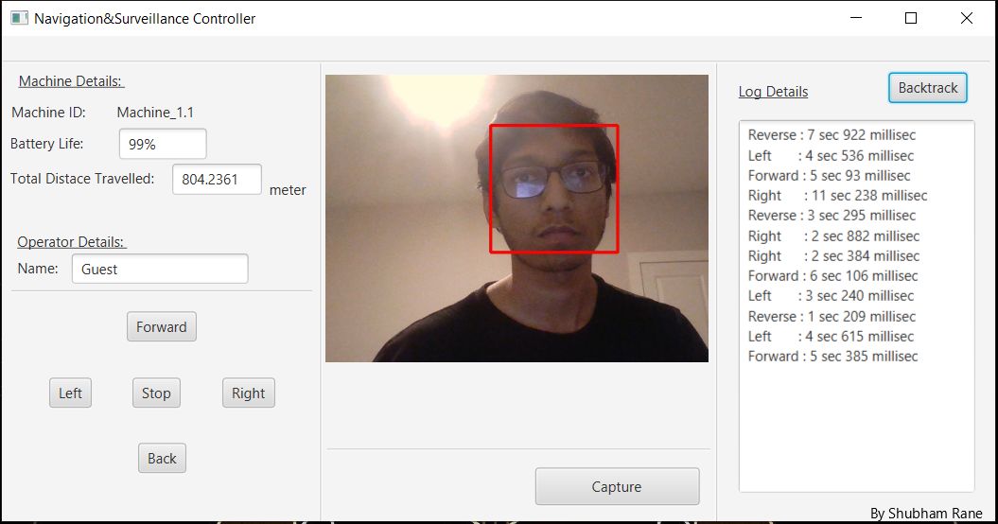
Controller backtracked
On top right corner there is a button named Backtrack which reverses all the body movement commands to for the situations like when cannot confirm visual of or from vehicle.
Picture demonstrates the same.

Slide 5
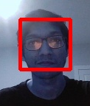
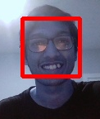
Project also makes successful use of computer vision libraries for specified object detections and tracking with the help of provided cascade files.
Image demonstrates face detection and tracking for example purpose.
Capture button on bottom center side allows use to capture pictures with applied detection model, image demonstrates the same.

Slide 6
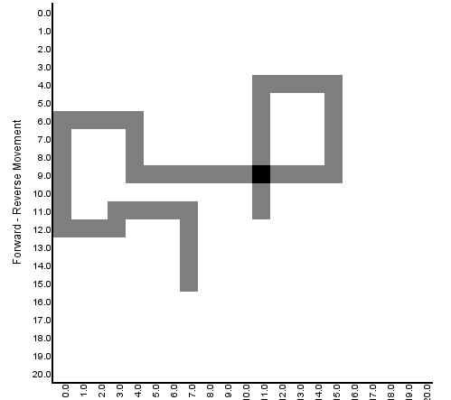
HeatMap
Last but not the least, keeping extensive use of vehicle it can be tiresome to go through hlog files to get the location of the vehicle.
Application allows use to visualize activity of vehicle in through an image file considering 3D environment.
Image demonstrates commands from previous images with starting point as 11,11 (center) and speed of 1 square per second.

